Slide 1
Behavioural Aspects of Physical Activity
Physical Activity, Health and Wellbeing
Sandra Okwara
06/10/22

Slide 2
Learning outcomes
Consider potential barriers to physical activity
Review and discuss behaviour change theories with respect to physical activity
Identify and discuss relevant and recent research and evidence

Slide 3
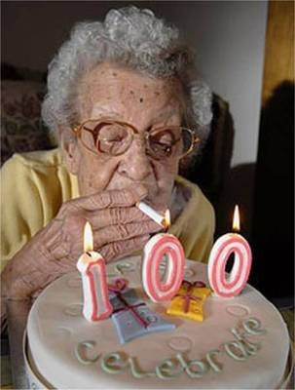
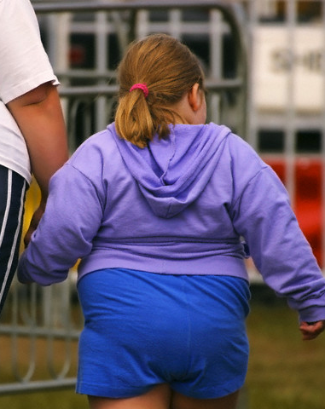
Three modern trends that will increase the prevalence of NCDs in this century
Epidemic of obesity
Inactivity in children
Increasing age of the population
(Hardman and Stensil 2009)

Slide 4
Three main behaviours…..that cause preventable deaths
Smoking
Poor diet
Physical inactivity
(Hardman and Stensil 2009)
All of these are lifestyle behaviours

Slide 5
Evidence so far
Already this module we have discussed the significance of an active lifestyle on NCD prevention
There appears to be an overwhelming volume of epidemiological evidence to support the increase in PA and the decrease in physical inactivity and sedentary behaviour at individual and population level
This is a key public health priority
So why do we still have a problem of insufficient physical activity?

Slide 6
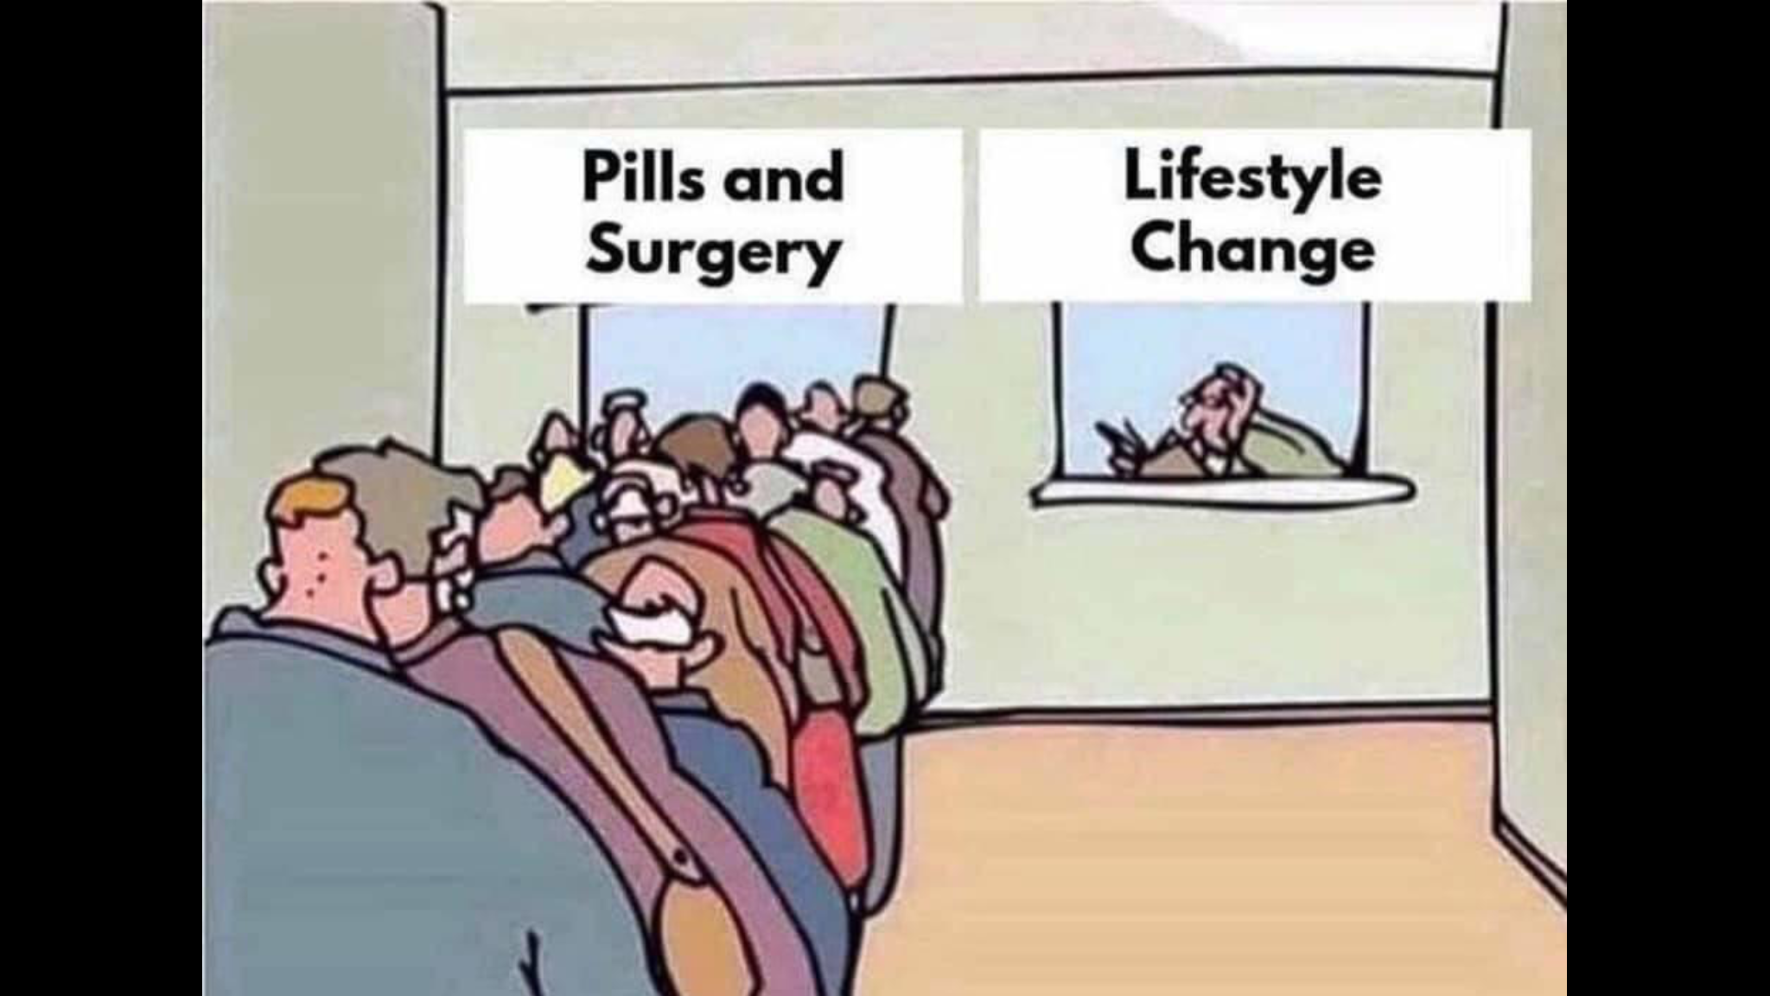

Slide 7
Lifestyle…
Multiple lifestyle risk
‘Clustering’ of unhealthy behaviours
70% of adults engage in two or more unhealthy behaviours (excess alcohol , poor diet, low PA, smoking)
People with no qualifications are five times more likely to engage in all four behaviour than those of high educational attainment
(Buck and Frosini, 2012)

Slide 8
Belloc, Breslow and Enstrom (1972) considered 7 health behaviours:
Sleeping 7-8 hours per day
Having breakfast everyday
Not smoking
Rarely eating between meals
Being near or at a prescribed weight
Having moderate or no use of alcohol
Taking regular exercise
Notes:
TUTOR NOTES
A fun activity – ask the students how many of the 7 health behaviours they ascribe to. Do a show of hands round the room or ask everybody to stand up and then sit down at their number. Usually only a few individuals actually ascribe to more than 3 or 4! This reminds the students that most health professionals do not necessarily adopt healthy behaviours, so ‘’being judgemental’ when working with service users is often very hypocritical!

Slide 9
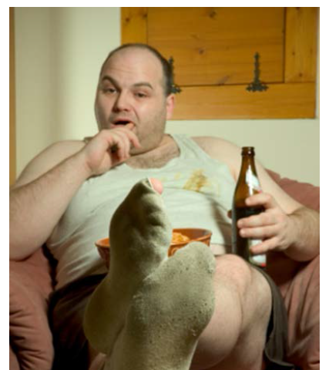
Let’s get Mike active

Slide 10

“Mike, why don’t you get off the bus a stop earlier?”

Slide 11
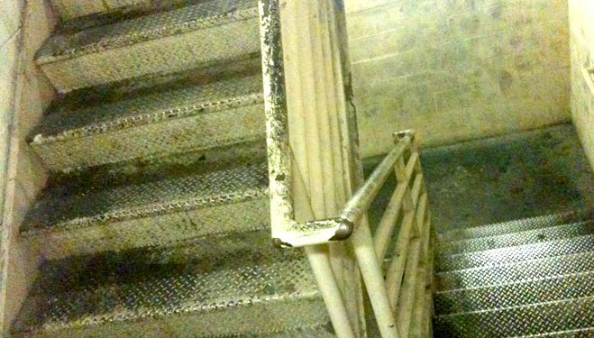
“Mike, you really should take the stairs instead of the lift”

Slide 12
Have you tried cycling to the shops?
More on this in Active Travel / Built Environment

Slide 13
Barriers to being active
Personal
Demographic
Cognitive/psychological
Social
Environmental
To be discussed later in the module
Notes:
Group brain storm - Flip chart ideas

Slide 14
Personal factors influencing PA (Dishman, Heath and Lee, 2013)
Factor | Influence *
Demographics
Increasing age
Blue-collar occupation
Higher level of education
Gender (male)
High risk of heart disease
Higher SES
Injury history
Overweight/obesity
Race (non-white)
Pregnancy and early child rearing
* positive, negative, neutral, unknown or unclear
Notes:
Use as a quiz – reveal factors and ask if positive or negative

Slide 15
Personal factors influencing PA (Dishman, Heath and Lee, 2013)
Factor | Influence
Demographics
Increasing age | Negative
Blue-collar occupation | Negative
Higher level of education | Positive
Gender (male) | Positive
High risk of heart disease | Negative
Higher SES | Positive
Injury history | Unclear
Overweight/obesity | Negative
Race (non-white) | Negative
Pregnancy and early child rearing | Negative
Notes:
Use as a quiz – reveal factors and ask if positive or negative

Slide 16
Personal factors influencing PA (Dishman, Heath and Lee, 2013)
Factor | Influence
Cognitive variables
Positive attitude
Perceived barriers to exercise
Self-efficacy
Enjoyment of exercise
Expected benefits
Value of expected outcomes
Self-motivation
Intention to exercise
Knowledge of health and exercise
* positive, negative, neutral, unknown or unclear
Notes:
Use as a quiz – reveal factors and ask if positive or negative

Slide 17
Personal factors influencing PA (Dishman, Heath and Lee, 2013)
Factor | Influence
Cognitive variables
Positive attitude | Positive
Perceived barriers to exercise | Negative
Self-efficacy | Positive
Enjoyment of exercise | Positive
Expected benefits | Positive
Value of expected outcomes | Positive
Self-motivation | Positive
Intention to exercise | Positive
Knowledge of health and exercise | Neutral
Notes:
Use as a quiz – reveal factors and ask if positive or negative

Slide 18
Social factors influencing PA (Dishman, Heath and Lee, 2013)
Factor | Influence
Class size
Exercise risk models
Good group cohesion
Physician influence
Past family influences
Social support (friends, peers)
Social support (spouse, family)
Social support (staff, instructor)
* positive, negative, neutral, unknown or unclear

Slide 19
Social factors influencing PA (Dishman, Heath and Lee, 2013)
Factor | Influence
Class size | Unknown
Exercise risk models | Unknown
Good group cohesion | Positive
Physician influence | Positive
Past family influences | Positive
Social support (friends, peers) | Positive
Social support (spouse, family) | Positive
Social support (staff, instructor) | Positive

Slide 20
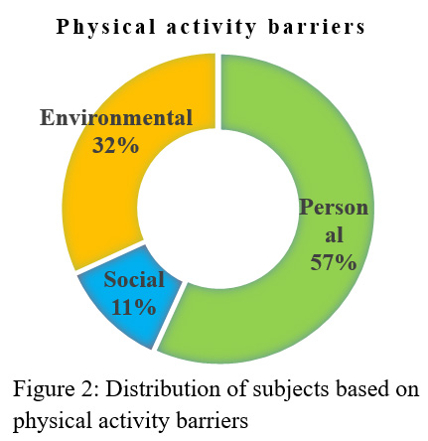
Perceived PA barriers in students - Anjali and Sabharwal (2018)
Common focus group responses
Lack of energy/sleep
Physical ailments/discomfort
Time
Lack of knowledge/skills
Procrastination
Lack of self-efficacy
Family control/peer pressure/discouragement
Excessive use of technology
Lack of facilities
Cost
Environment/safety
Weather

Slide 21
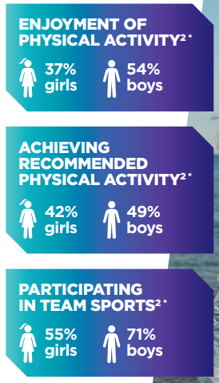
PA disengagement in teenage girls
Sport England/Women in Sport report published this week
https://www.womeninsport.org/wp-content/uploads/2022/03/Tackling-Teenage-Disengagement-March-2022.pdf
Too many girls disengage with PA/sport in their teens
Self-belief, capability, body image concerns
Physical and emotional impact of puberty
Fathers/father figures tend to be more supportive of their sons playing sport

Slide 22
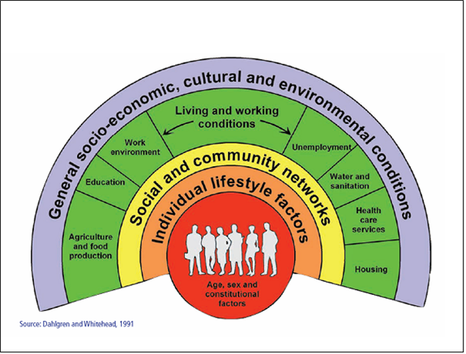
The wider determinants of health

Slide 23
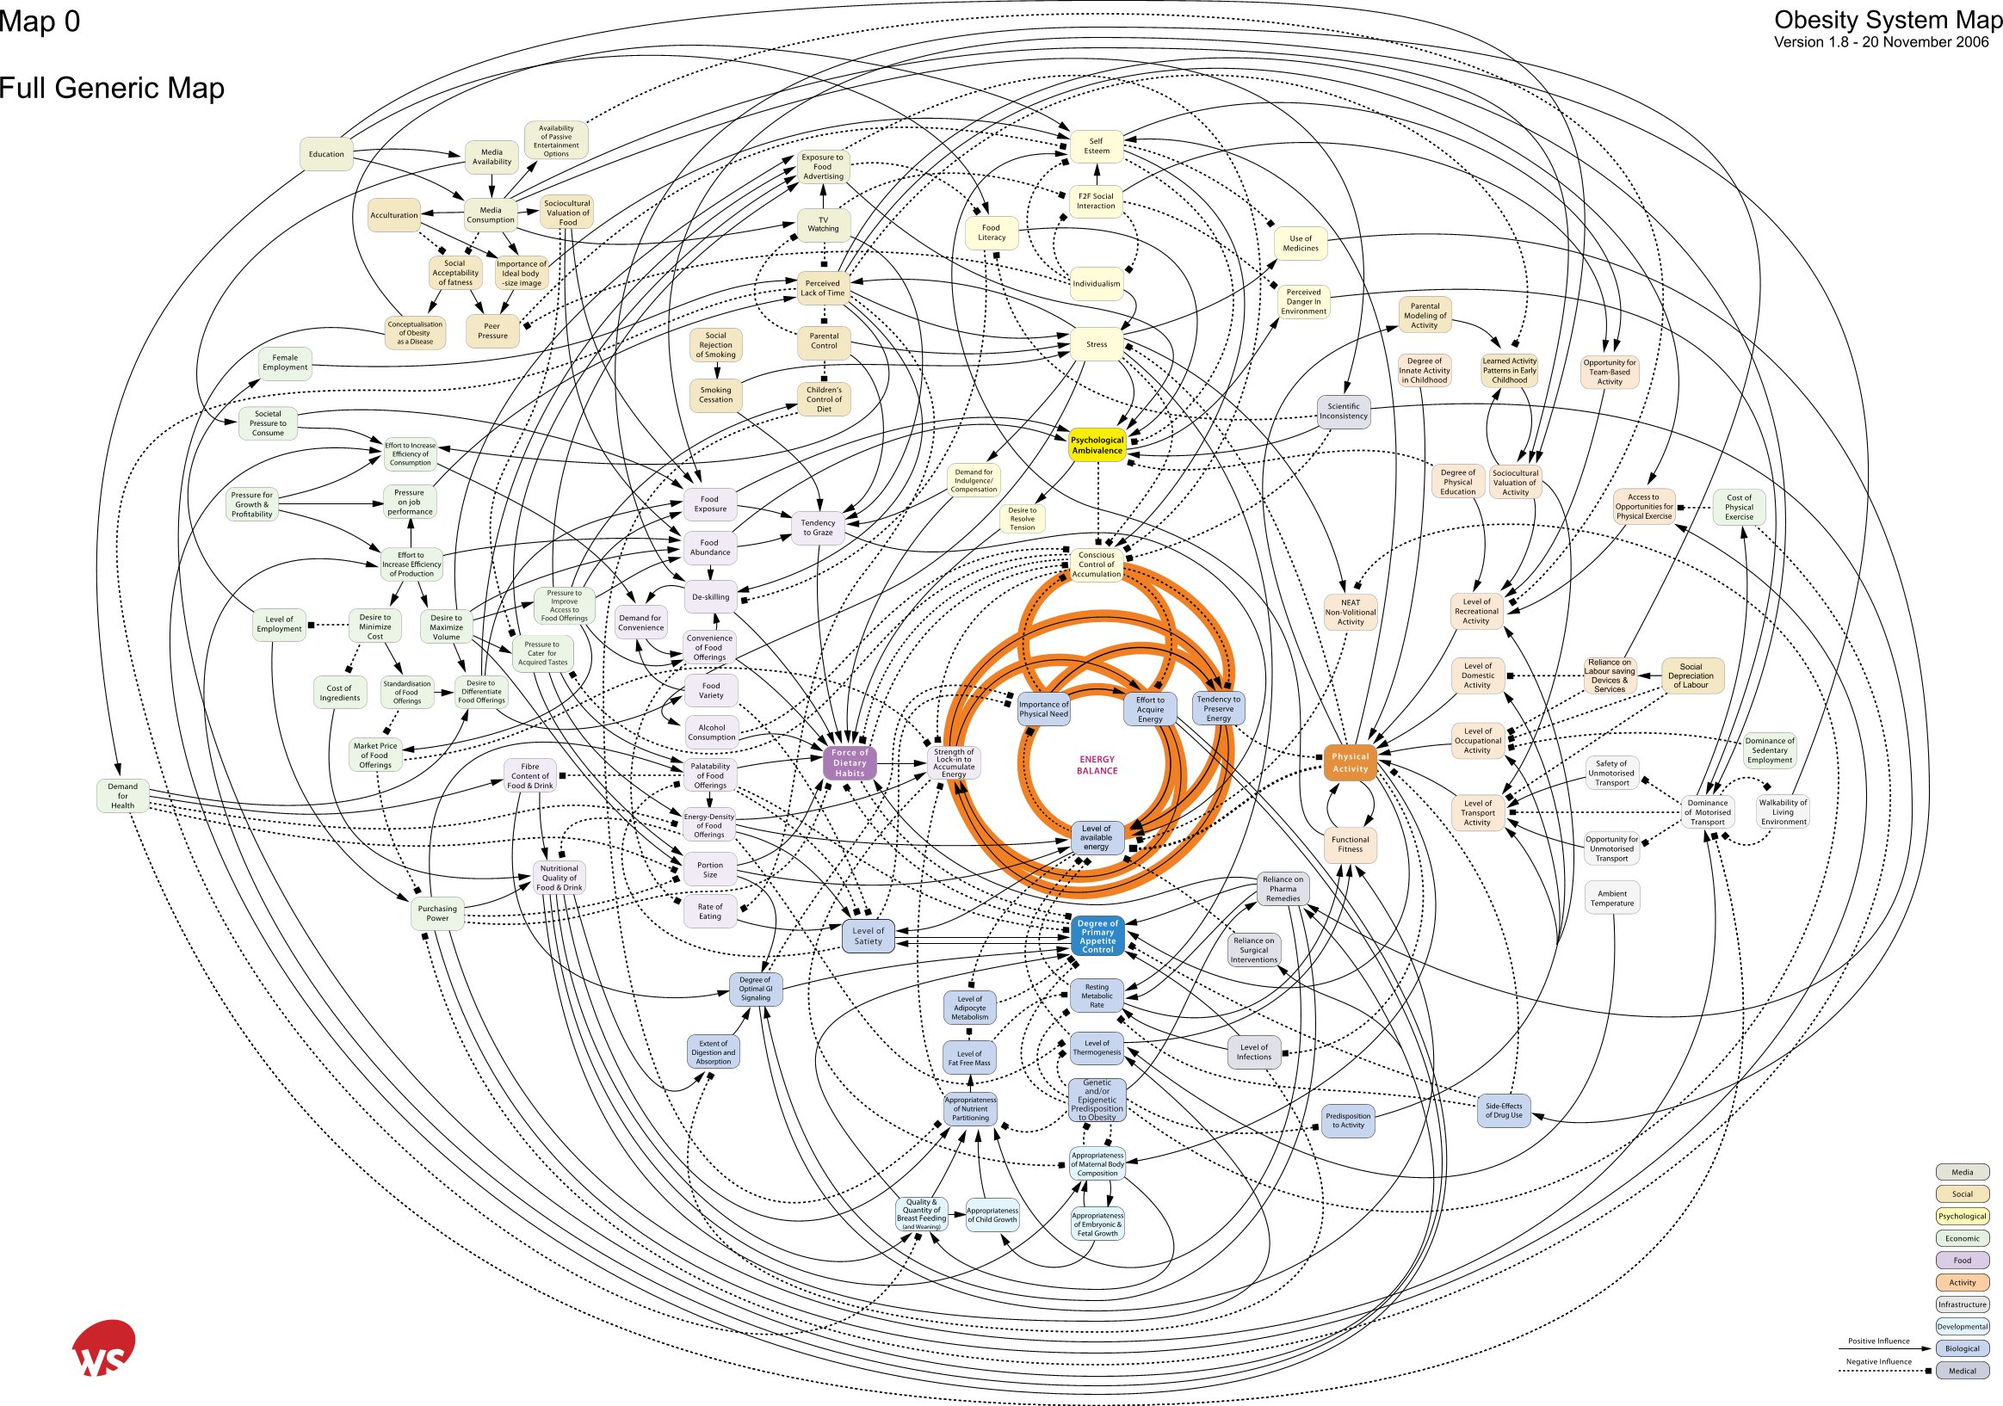
The obesity system map
Societal influences
Individual psychology
Individual activity
Food Production
Food
Consumption
Activity environment
Biology
Notes:
Psychology clearly has an important place not just in the way it directly affects energy balance but also through its influences on
food consumption and activity a
the way we see ourselves in society
Interact with food supply through shopping
Way we perceive the activity environment in terms of risk and reward
The key factor however that solutions are likely to require multidisciplinary solutions. Hence the major emphasis by funders these day to create partnerships and teams of academics – something I will talk about later.

Slide 24
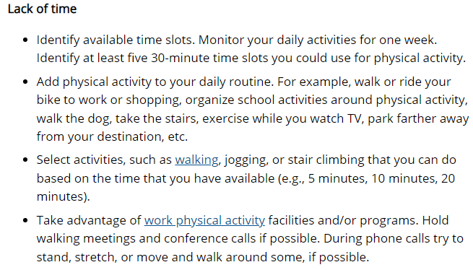
Suggestions for overcoming PA barriers
CDC (2022)
www.cdc.gov/physicalactivity/

Slide 25
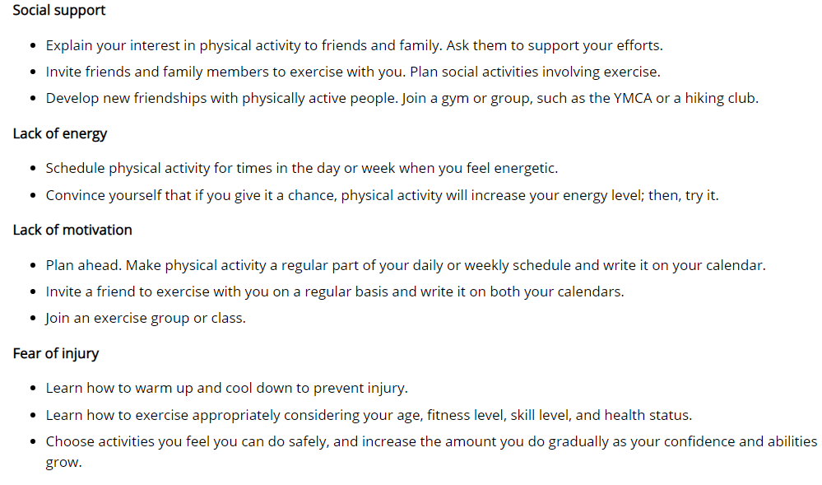
Suggestions for overcoming PA barriers
CDC (2022)
www.cdc.gov/physicalactivity/

Slide 26
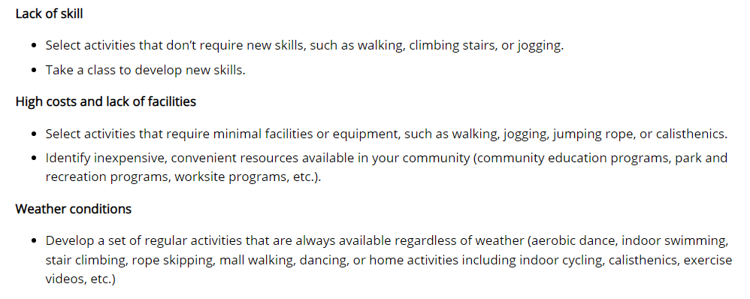
Suggestions for overcoming PA barriers
CDC (2022)
www.cdc.gov/physicalactivity/

Slide 27

What influences our behaviour?
Individual: knowledge, attitudes, beliefs, personality
Interpersonal: family, friends, peers
Community: social networks, standards, norms
Institutional: rules, policies, informal structures
Public Policy: local policies related to healthy practices
Notes:
Health-related behaviours are affected by, and affect, multiple levels of influence: intrapersonal or individual factors, interpersonal factors, institutional or organizational factors, community factors, and public policy factors.
Individual factors are individual characteristics such as knowledge, attitudes, beliefs, and personality traits that influence behaviour.
Interpersonal factors are interpersonal processes, and primary groups including family, friends, and peers that provide social identity, support, and role definition.
Institutional factors are rules, regulations, policies, and informal structures that may constrain or promote recommended behaviours.
Community factors are social networks and norms or standards that exist formally or informally among individuals, groups, and organizations.
Public policy factors are local, state, and federal policies and laws that regulate or support healthy actions and practices for disease prevention, early detection, control, and management.

Slide 28
Changing people’s behaviour
“Over 75% of individuals do not maintain behaviour changes in multiple areas of behaviour including substance use, smoking, physical activity, nutrition, and management of chronic physical and mental health conditions”
(Naar-King et al., 2013)

Slide 29
The role of beliefs in behaviour change
To be motivated, people must believe:-
That not changing their behaviour will pose a threat to their health (situation-outcome).
That changing behaviour will reduce this threat (action-outcome)
That they are capable of changing behaviour (self-efficacy: Bandura, 1986)

Slide 30
Self-efficacy (Bandura, 1986)
Four general factors;
Direct experience
Vicarious experience
Verbal persuasion
Physiological state
Exists when people feel capable of changing behaviour i.e. believe that they have sufficient:
Internal resources: will-power, motivation, skills and
External resources: access, time, support, money

Slide 31
Motivation
Intrinsic motivation refers to behaviour driven by internal rewards:
Fulfilling
Enjoyable
Satisfying
Extrinsic motivation is driven by external reward or to avoid negative outcomes:
Get something in return
Pass the course
Earn money

Slide 32
Behavioural regulation (Biddle, Mutrie and Gorely, 2015)
External regulation – behaviour is controlled by rewards, threats and possible concern
GP suggests you should be more active
Your peer group tell you to take up running with them
Introjected regulation – individual is acting out of avoidance of negative feelings, e.g. guilt
I pay £60 a month for my gym membership
I need to be active or my health studies peer group will moan at me

Slide 33
Behavioural regulation (Biddle, Mutrie and Gorely, 2015)
Identified regulation – action is motivated by an appreciation of valued outcomes of participation
I want to be active as I want to get fitter
I take part in netball trials because I want to get into the Uni team
Integrated regulation – behaviour is performed to satisfy important personal goals that represent the person’s self identity
I go to the gym because I am a healthy person
I run because I am good at running

Slide 34
Behavioural theoretical frameworks featured in PA/exercise psychology
Attribution theory
Theory of planned behaviour
Self-efficacy theory
Self-perception models
Achievement goals theory
Goal setting theories
Health belief model
Trans-theoretical model (Stages of Change)
Health action process approach
(Biddle, Mutrie and Gorely, 2015)

Slide 35
The Health Belief Model (HBM) (Rosenstock, 1966)
Behaviour is the result of an individual’s core beliefs, which develop over time.
People will carry out a preventive health behaviour in response to a perceived threat.
Behaviours are the result of rational processing.
Emphasise the cognitions of the individual person.

Slide 36
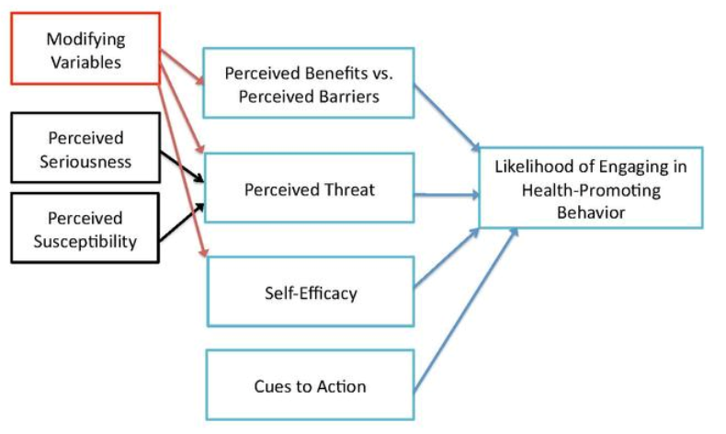
The Health Belief Model (HBM) (Rosenstock, 1966)

Slide 37
The Health Belief Model (HBM) (Rosenstock, 1966)
A health-related action will occur if:
The person believes that the negative health condition can be avoided
The person believes that their action will lead to avoidance of the health problem.
The person believes that they can carry out the required action (self-efficacy).

Slide 38
Theory of Planned Behaviour (Ajzen, 1991)
This model explains how our attitudes and beliefs are linked to our behaviours (including health-related behaviours).
If we can understand how the two are linked, we can predict and change behaviour – very useful in public health.

Slide 39
Theory of Planned Behaviour (Ajzen, 1991)
The model is comprised of the following ‘constructs’:
Attitudes: the degree of favourability towards an attitude object, based on cognitive, affective and behavioural information (Eagly and Chaiken, 1993, cited in Haddock and Zanna, 1999).
Subjective norms: the person’s judgement about what other people think they should do.
Perceived behavioural control: The person’s perceptions about the ease/difficulty of performing the behaviour (added to the earlier version of this model, the Theory of Reasoned Action (Fishbein and Ajzen, 1975).

Slide 40
Theory of Planned Behaviour (Ajzen, 1991)
Beliefs & Evaluation about outcome of action
Attitude
Beliefs about others’ expectations
Motivation to comply to others’ expectations
Subjective Norm
Intention
Behaviour
Internal & external control factors -barriers & benefits
Perceived Behavioural Control
Notes:
Intention to perform behaviour is the most influential factor in determining behaviour. Intention is determined by:
Attitude: the overall evaluation of performing the behaviour; Social norm: beliefs about the views of important others & how motivated the individual is to comply with others and people’s perceptions of their ability to be able to perform a particular behaviour i.e.. Perceived behavioural control (HLOC)

Slide 41
The Transtheoretical Model (TTM) (Prochaska and DiClemente, 1983)
Pre-contemplation – the individual has not considered change
Contemplation – considering behaviour change
Preparation – making small changes
Action – Actively carrying out the new behaviour
Maintenance – Sustaining this new behaviour over time
Relapse - may happen at any stage (i.e. resume the old behaviour).
Termination - the individual may give up the old behaviour altogether (although for how long…?).

Slide 42
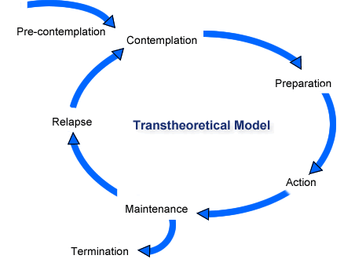
The Transtheoretical Model (TTM) (Prochaska and DiClemente, 1983)

Slide 43
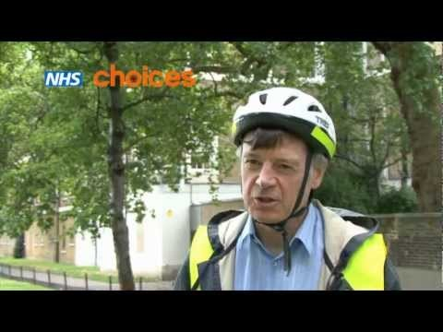
So how do we make changes?

Slide 44
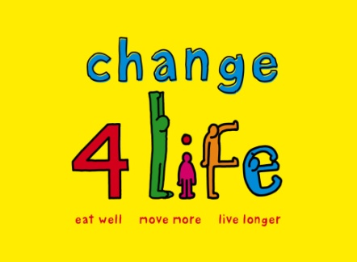

Is health behaviour simply a case of;
Being informed?
Making intelligent choices?
Having positive attitudes?
Making health a priority?
A nudge in the right direction?
(Thaler and Sunstein, 2008)
Notes:
Have Governments taken a rather naive approach?
Their belief seems to be that the answer is in influence over choice – largely by more information.
Public media campaigns
Death by pamphlets
More progressive have tried a range of tactics to influence attitudes
From the crudest scare tactics
To the influence of your behaviour on other close to you - increase your chances of getting a partner – smoking campaigns to harming your unborn child

Slide 45
Nudge theory
A nudge is a small and apparently insignificant detail that can have a major impact on people’s behaviour
Thaler and Sunstein (2008)
Nudges are used to alter lifestyles and curb the rise of NCDs
In principle, this is an effective approach to promoting PA
Nudges could appear as written information, pictures, signs, rules or guidance
Behaviour can be influenced by changing contexts
E.g., the environment
Also known as ‘choice architecture’ – not mandatory
Forberger et al. (2019)

Slide 46
Nudge theory
Images of footsteps on the floor encouraged office workers to use the stairs rather than the lift
Nudge interventions perceived as fun and engaging and incorporate creative visuals were more successful
Van der Meiden, Kok and Van der Velde (2019)
NB. Study done in office location due to rise in sedentary working habits. Similar sedentary behaviours occur within education settings so concepts could be applied for your poster interventions

Slide 47
Nudge theory in action
Behavioural Insights Team have been working with DHSC, PHE, NHS England
Making the healthy option easier
For example, The Alfred Hospital, Victoria, Australia
Moved high-sugar drinks to a less prominent location
Price of high-sugar beverages in vending machines increased by 20%
Outcomes suggested that sales were not affected but people had moved from buying high-sugar products to lower sugar ones
Halpern (2016)
Victoria State Government changed their public sector Healthy Choices Framework as a result

Slide 48
Example of a settings-based nudge intervention
This is an intervention based on healthy eating but might give you an idea of how nudge theory works and how it could be incorporated into your group poster assessments
https://www.alfredhealth.org.au/about/healthy-communities/healthy-food/point-of-sale-communication

Slide 49
Behaviour change guidance
Healthy lives, healthy people (2010)
MINDSPACE (2010)
NICE guidance on behaviour change
Individual approaches PH49 (2014)
General approaches PH6 (2007)

Slide 50
NICE PH49 (2014)
Systematic, evidence-based approach for health behaviour change interventions
Emphasises the importance of careful planning and theoretical underpinning
Stresses the need for clear definition of techniques so that they can be replicated
Process and outcome evaluation

Slide 51
References
Ajzen, I. (1991) ‘The Theory of Planned Behaviour’, Organizational Behaviour and Human Decision Processes, 50, pp. 179-211.
Anjali, and Sabharwal M. (2018) Perceived Barriers of Young Adults for Participation in Physical Activity. Current Research in Nutrition and Food Science; 6(2).
Biddle, S.J.H., Mutrie, N. and Gorely, T. (2015) Psychology of physical activity: determinants, wellbeing and interventions. 2nd ed. London: Routledge
Buck, D., and Frosini, F. (2012) Clustering of unhealthy behaviours over time. London: The Kings Fund.
Dishman, R.K., Heath, G.W. and Lee, I-M (2013) Physical Activity Epidemiology. 2nd ed. Champaigne, IL: Human Kinetics
Forberger, S., Reisch, L., Kampfmann, T. and Zeeb, H. (2019) Nudging to move: a scooping review of the use of chpoice architecture interventions to promote physical activity in the general population. International Journal of Behavioural Nutrition and Physical Activity 16 (77)
Green, L.W. and Kreuter, M.W. (1991). Health Promotion Planning: An Educational and Environmental Approach. Mountain View, CA: Mayfield.
Hardman, A.E. and Stensel, D. (2009) Physical Activity and Health: The evidence explained. London: Routledge.

Slide 52
References
Halpern, D. (2016) Behavioural insights and healthier lives. Victorian Health Promotion Foundation, Melbourne.
Michie, S., Ashford, S., Sniehotta, F., Dombrowski, S., Bishop, A., and French, D. (2011). A refined taxonomy of behaviour change techniques to help people change their physical activity and healthy eating behaviours: The CALO-RE taxonomy. Psychology and Health, 26(11), 1479-1498.
Mindspace (2010). Influencing behaviour through public policy. [Online] Available at: http://www.instituteforgovernment.org.uk/our-work/better-policy-making/mindspace-behavioural-economics (accessed 8 March 2022).
Naar-King, S., Earnshaw, P. and Breckon, J., 2013. Toward a universal maintenance intervention: Integrating cognitive-behavioural treatment with motivational interviewing for maintenance of behaviour change. Journal of Cognitive Psychotherapy, 27(2), pp.126-137.
Thaler, R. and Sunstein, C. (2008) Nudge; Improving decisions about health, wealth, and happiness., London: Yale University Press.
Van der Meiden, I., Kok, H. and Van der Velde, G. (2019) Nudging physical activity in offices. Journal of Facilities Management. 17 (4), p317-330.
Women in Sport (2022) Reframing sport for teenage girls: tackling teenage disengagement. Available at: https://www.womeninsport.org/wp-content/uploads/2022/03/Tackling-Teenage-Disengagement-March-2022.pdf (accessed 8 March 2022).

